Slide 1
The global genetic diversity of planktonic foraminifera
Raphaël Morard, Kate F. Darling, Tristan Cordier, Nicolas Henry, Christiane Hassenrück, Chiara Vanni, Mattia Greco, Agnes K. M. Weiner, Nele M. Vollmar, Tamara Milivojevic, Shirin Nurshan Rahman, Michael Siccha, Julie Meilland, Lukas Jonkers, Frédéric Quillévéré, Gilles Escarguel, Christophe J. Douady, Thibault de Garidel-Thoron, Colomban de Vargas, Michal Kucera

Slide 2
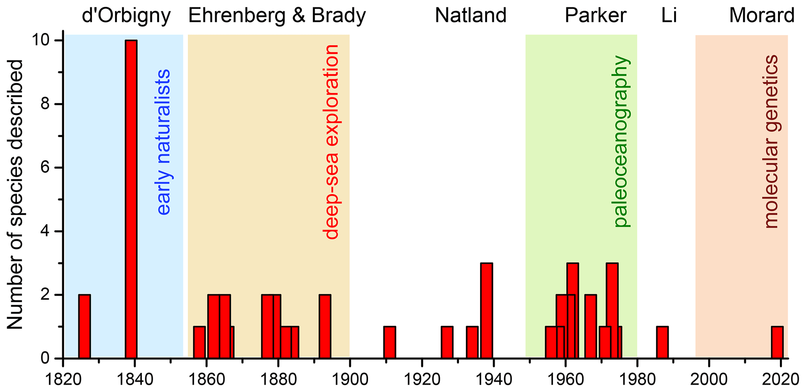
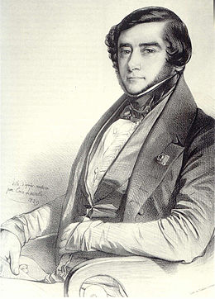
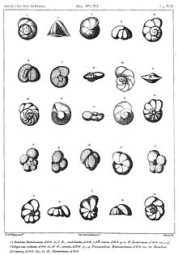
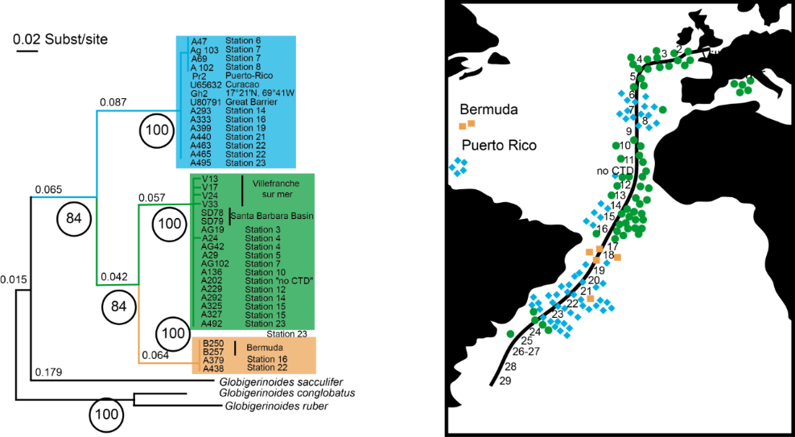
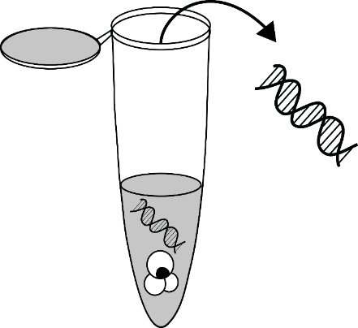
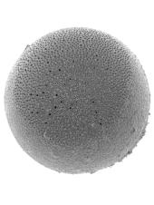
Modern planktonic foraminifera diversity - The clash of taxonomies
Two centuries of taxonomy
~ 50 modern morphospecies
of planktonic foraminifera
Morphology
Two decades of
single-cell sequencing
Morphology
underestimates
biological diversity
Molecular
de Vargas et al. (1999)

Slide 3
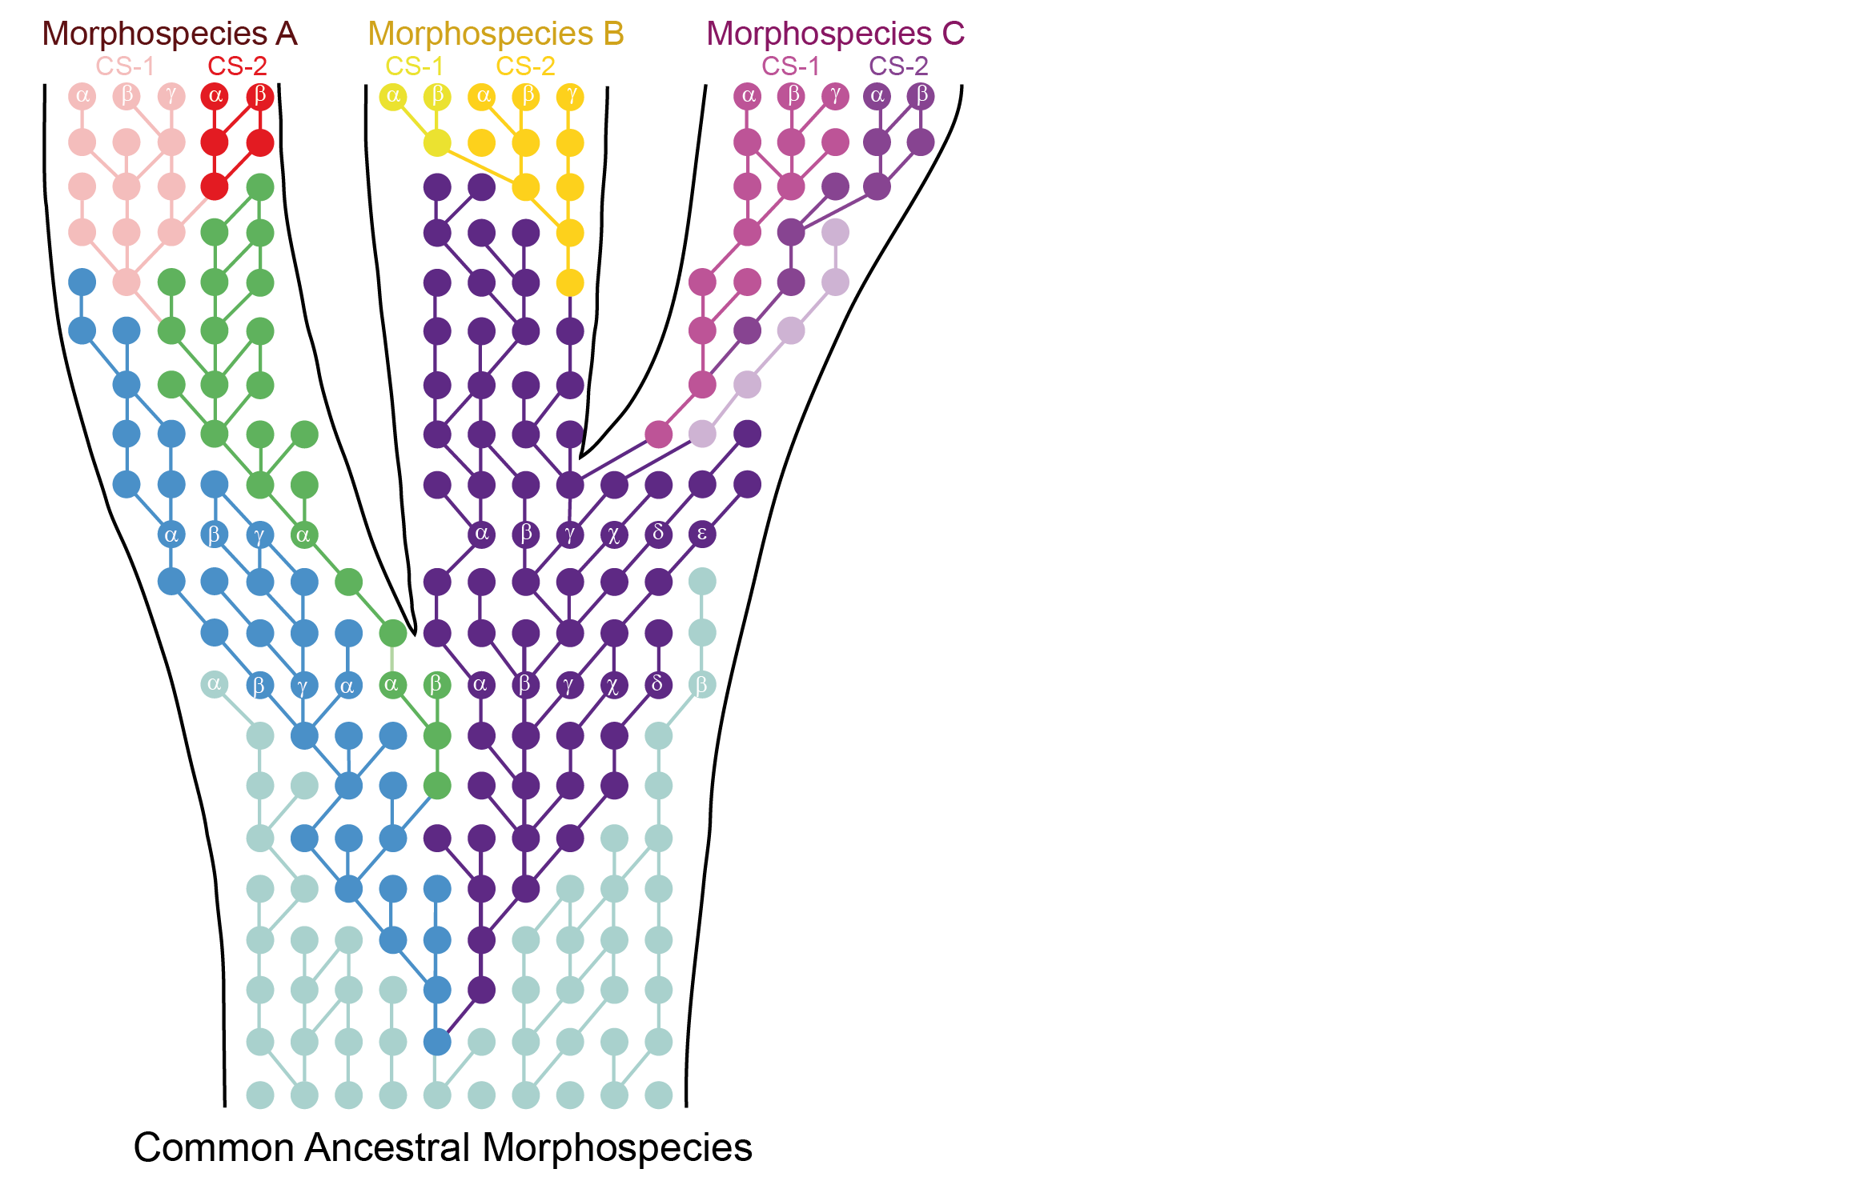
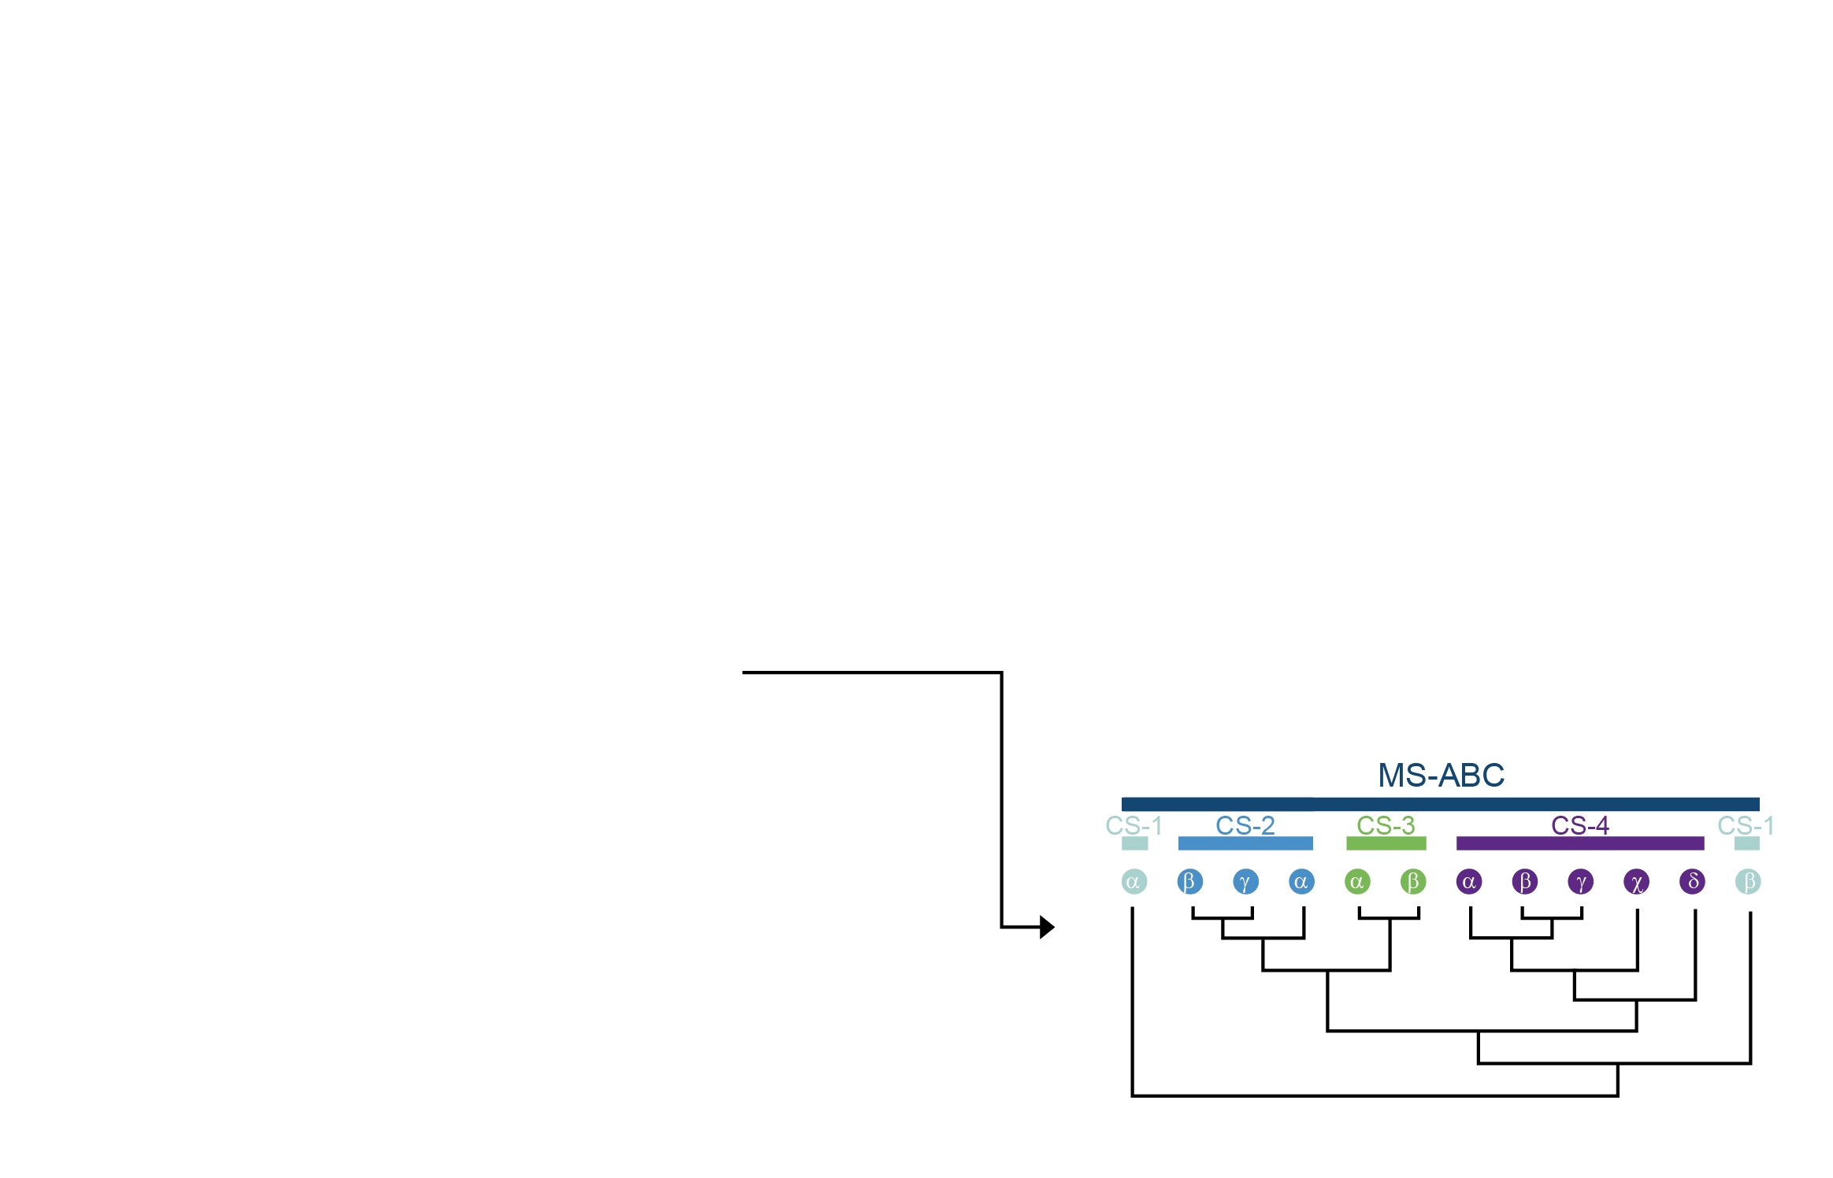
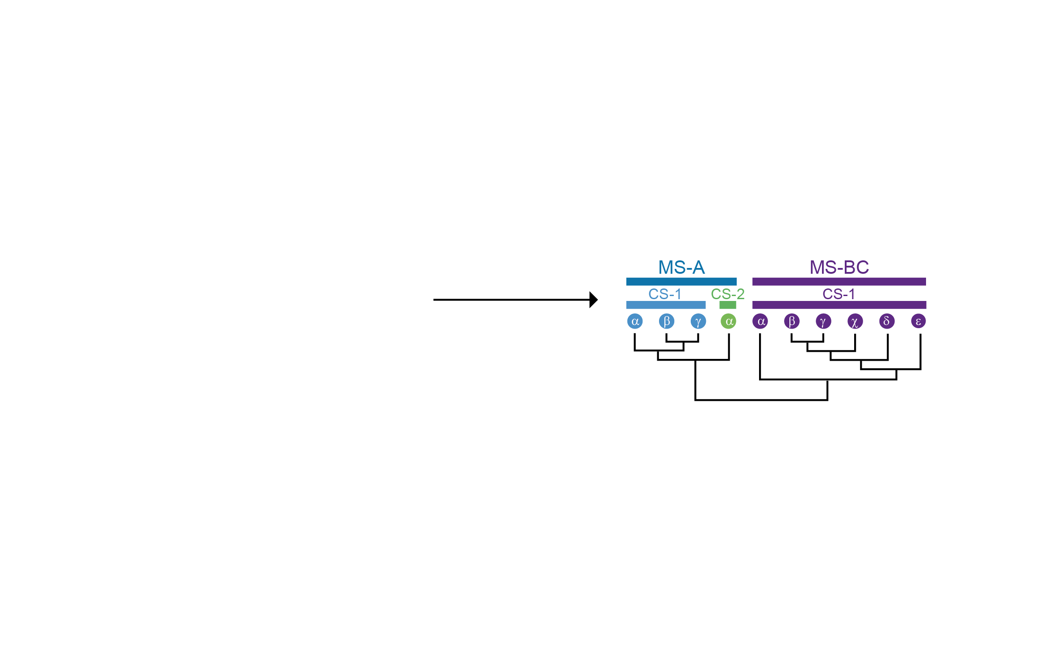
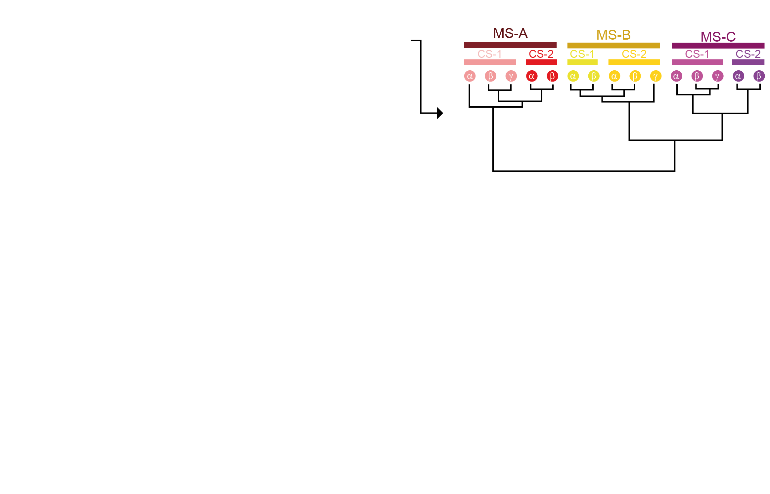
The perpetual motion of evolution

Slide 4

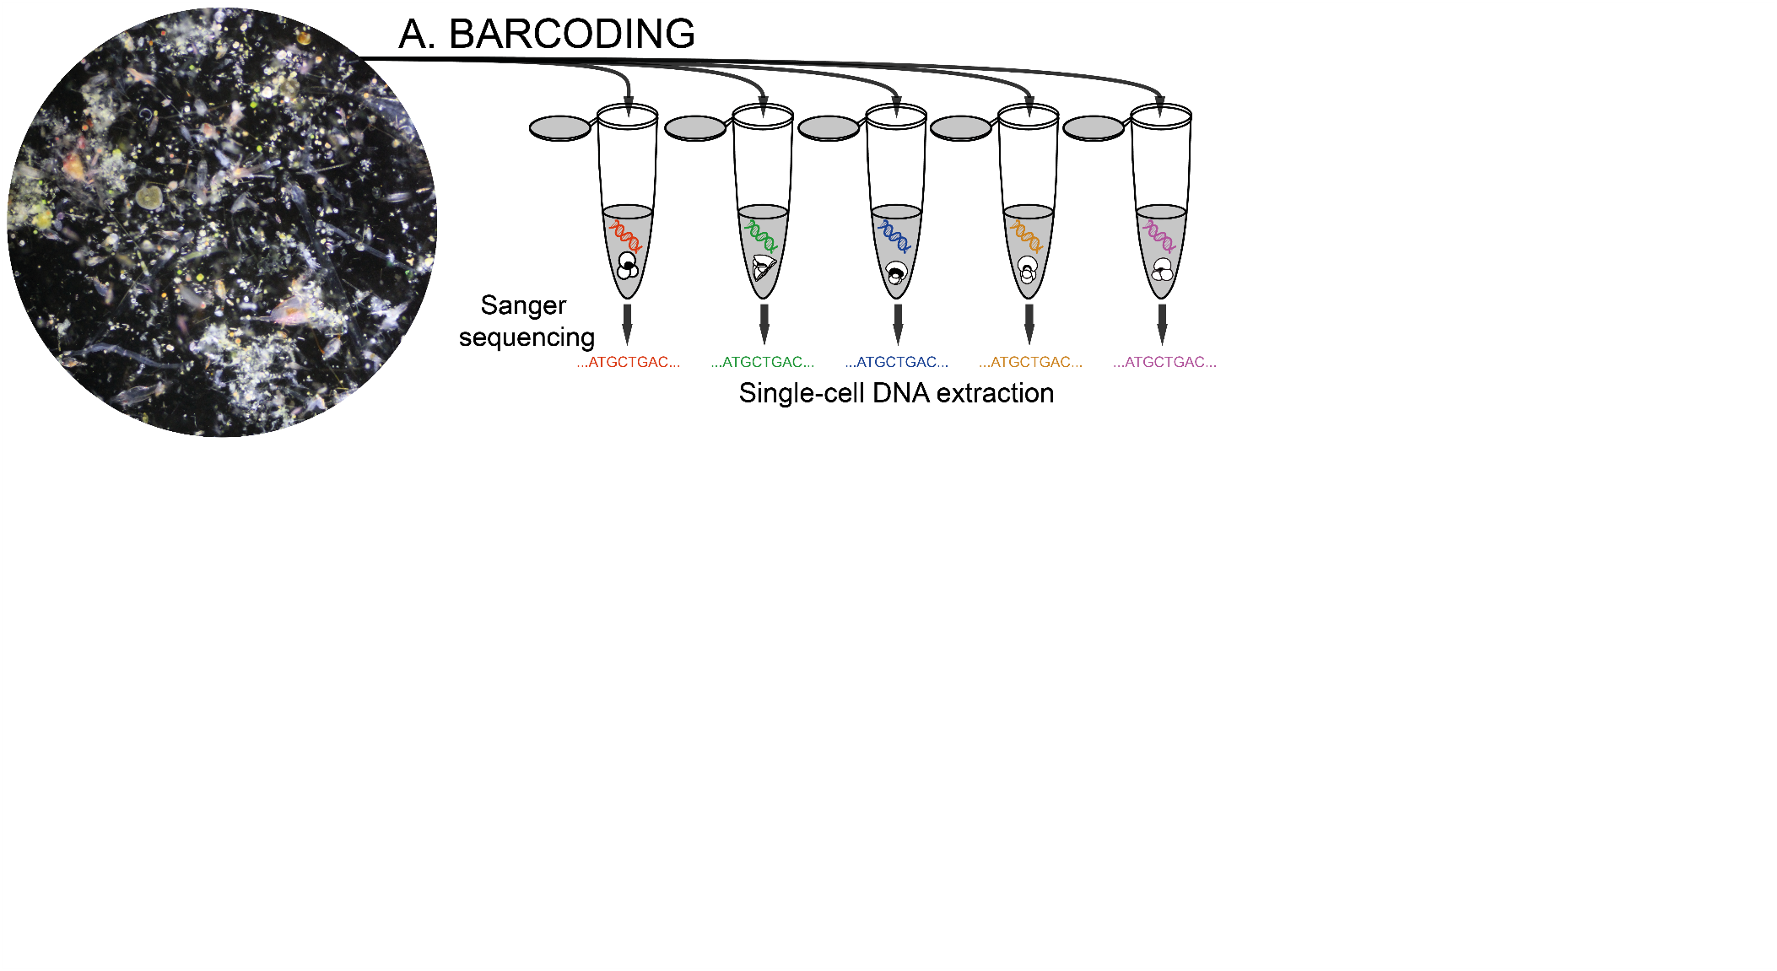
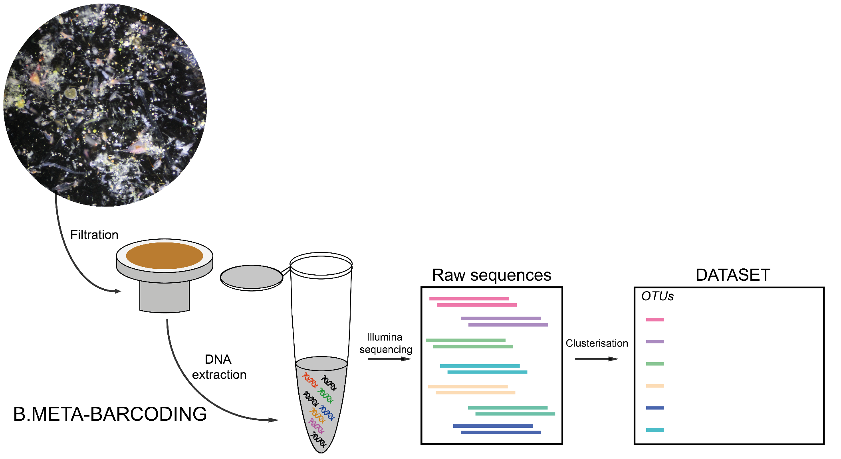
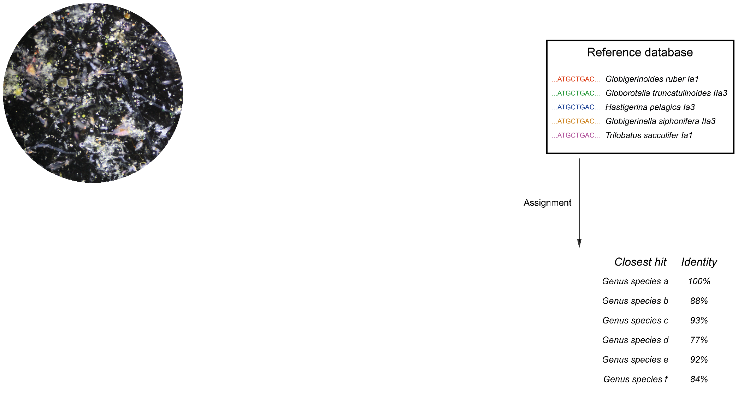
Data collection

Slide 5
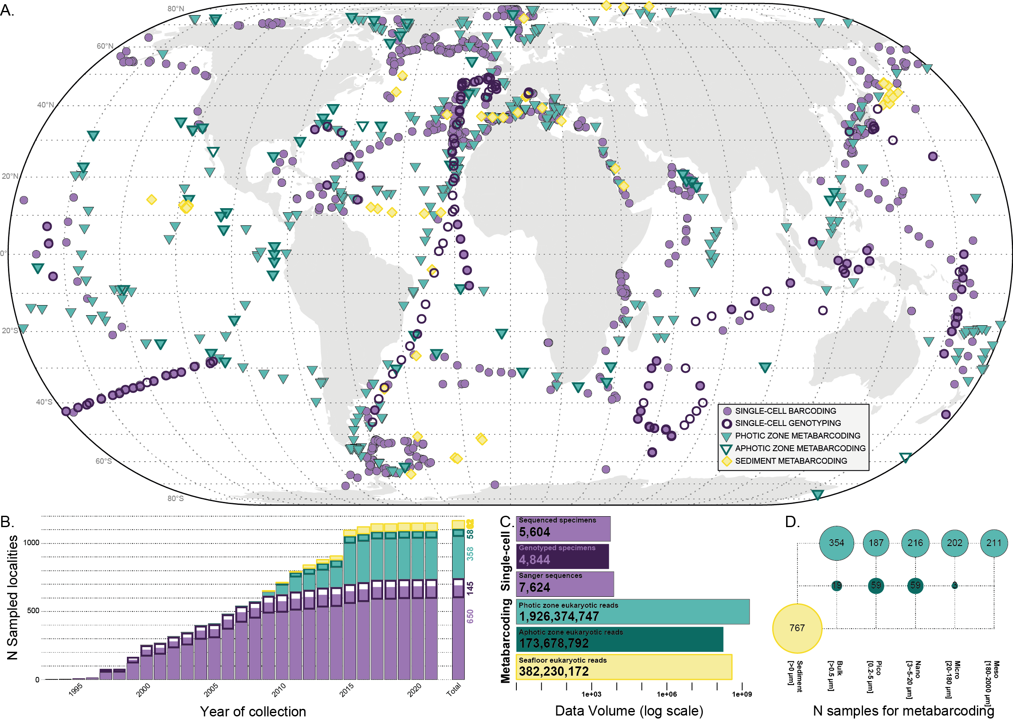
Data collection
Merging Barcoding and Metatabarcoding into a single framework

Slide 6
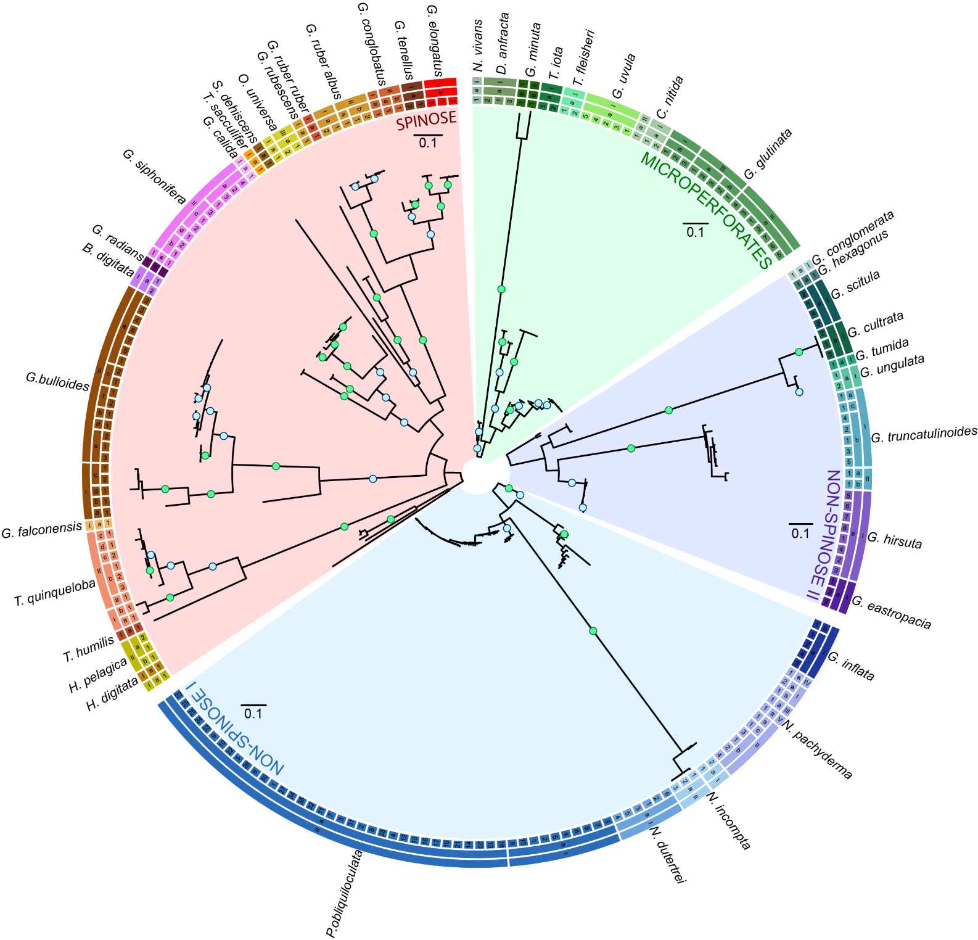
Rebuilding Molecular Taxonomy
3 levels Taxonomic system
41 MORPHOSPECIES Upper limit
59 LINEAGES (MOTUs lvl-1)
84 GENOTYPES (MOTUs lvl-2)
209 BASEGROUPS (MOTUs lvl-3)
353 BASTEYPES Lower limit

Slide 7
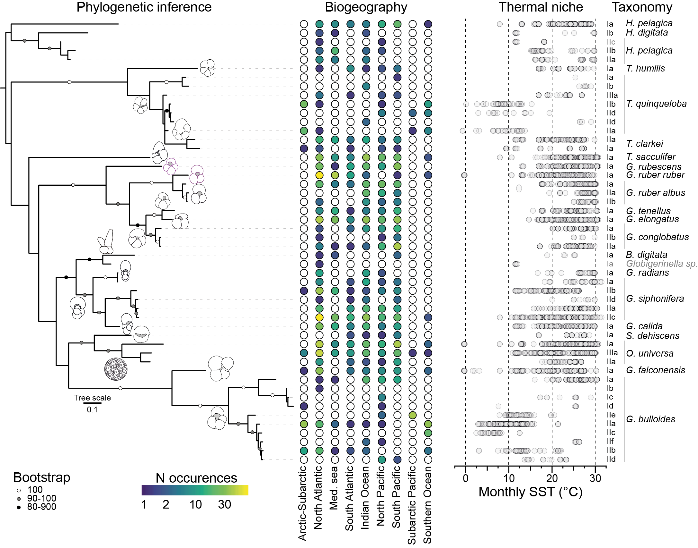
3 Major patterns of cryptic diversification
No evidence of cryptic diversification
(29 Morphospecies)
Cryptic diversification without habitat fragmentation
(8 Morphospecies)
Cryptic diversification
with habitat
fragmentation
(8 Morphospecies)

Slide 8
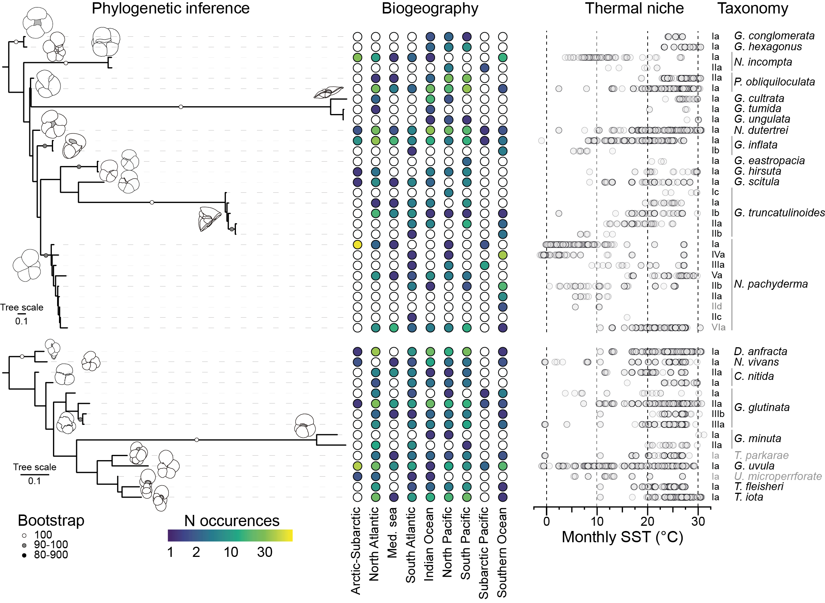
3 Major patterns of cryptic diversification
No evidence of cryptic diversification
(29 Morphospecies)
Cryptic diversification without habitat fragmentation
(8 Morphospecies)
Cryptic diversification
with habitat
fragmentation
(8 Morphospecies)

Slide 9
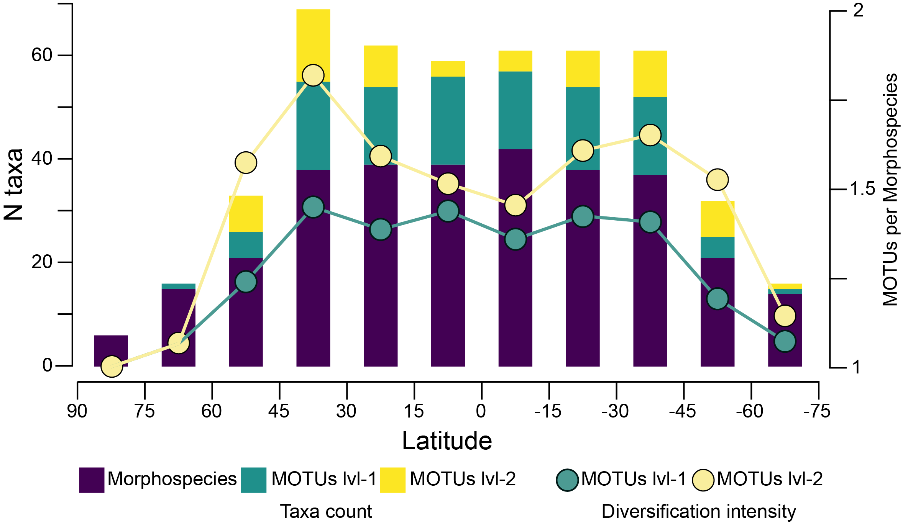
Latitudinal diversity gradient

Slide 10
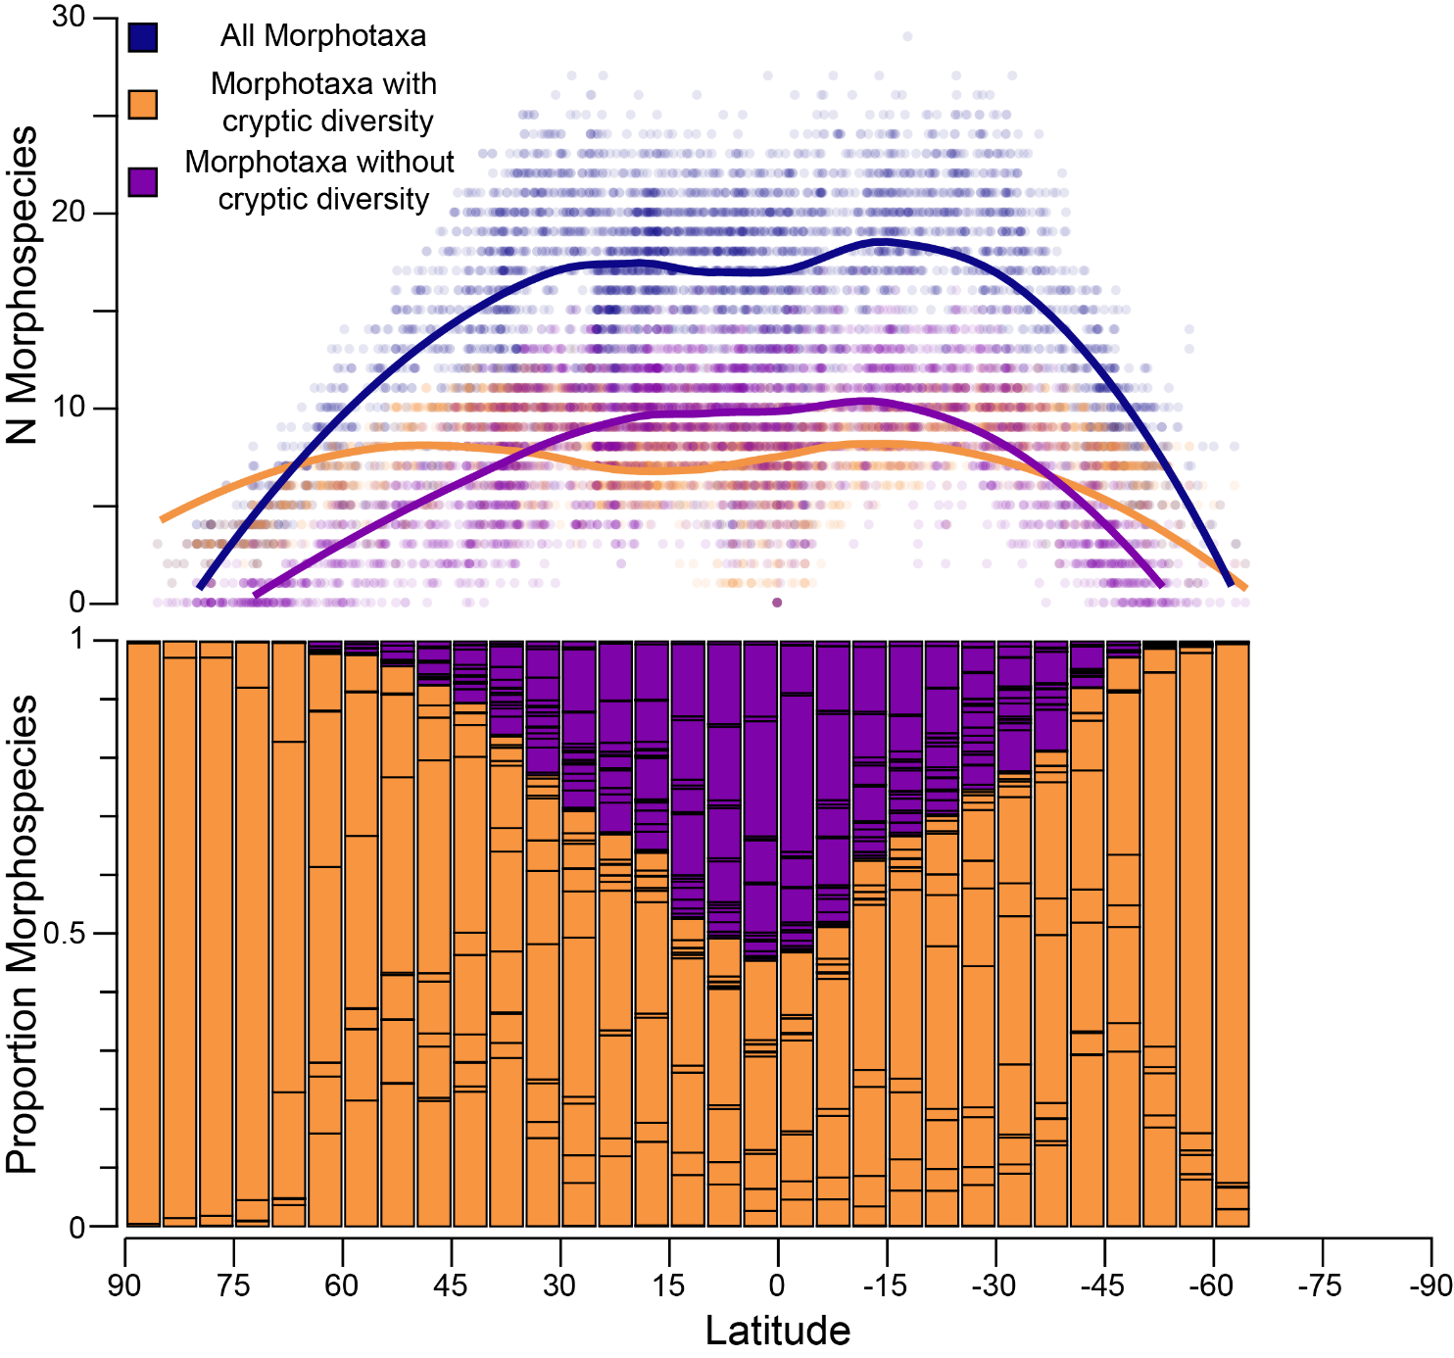
Distribution in fossil assemblages
FORCENS DB
Cryptic diversity is likely not the prevalent pattern in planktonic foraminifera
Major effect on mid to high latitude assemblages.
Primary driver of cryptic diversification is likely geography
Planktonic foraminifera are under-diversified

Slide 11
From the Antarctic planktonic speciation hub to an Arctic grave
Project idea

Slide 12
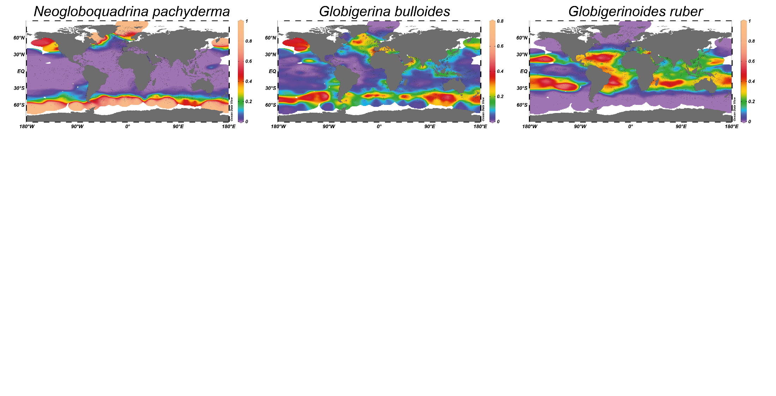
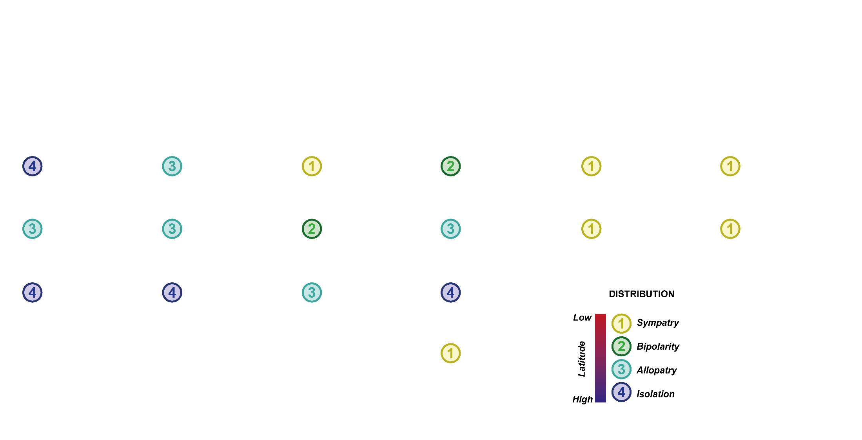
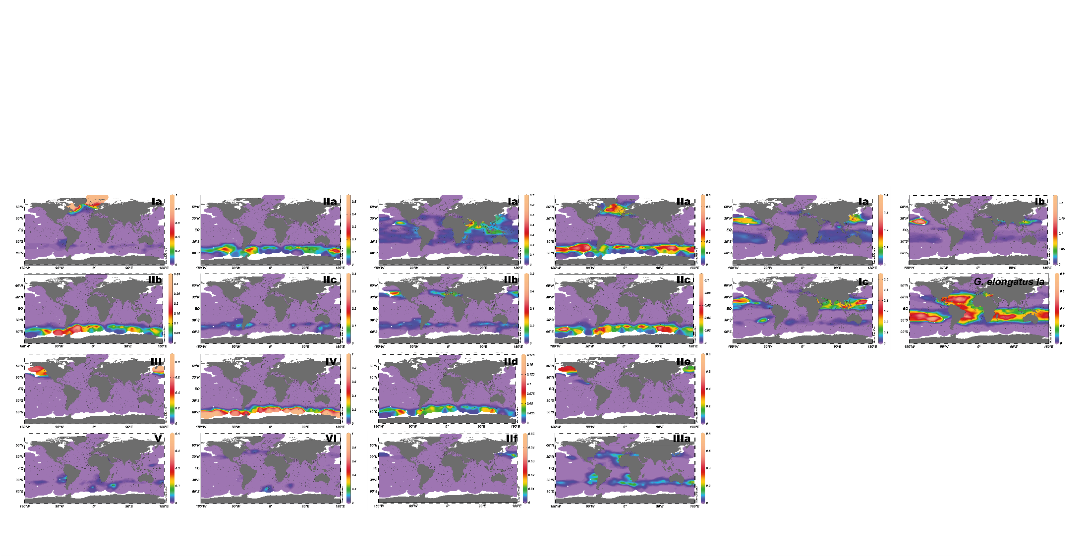


Slide 13
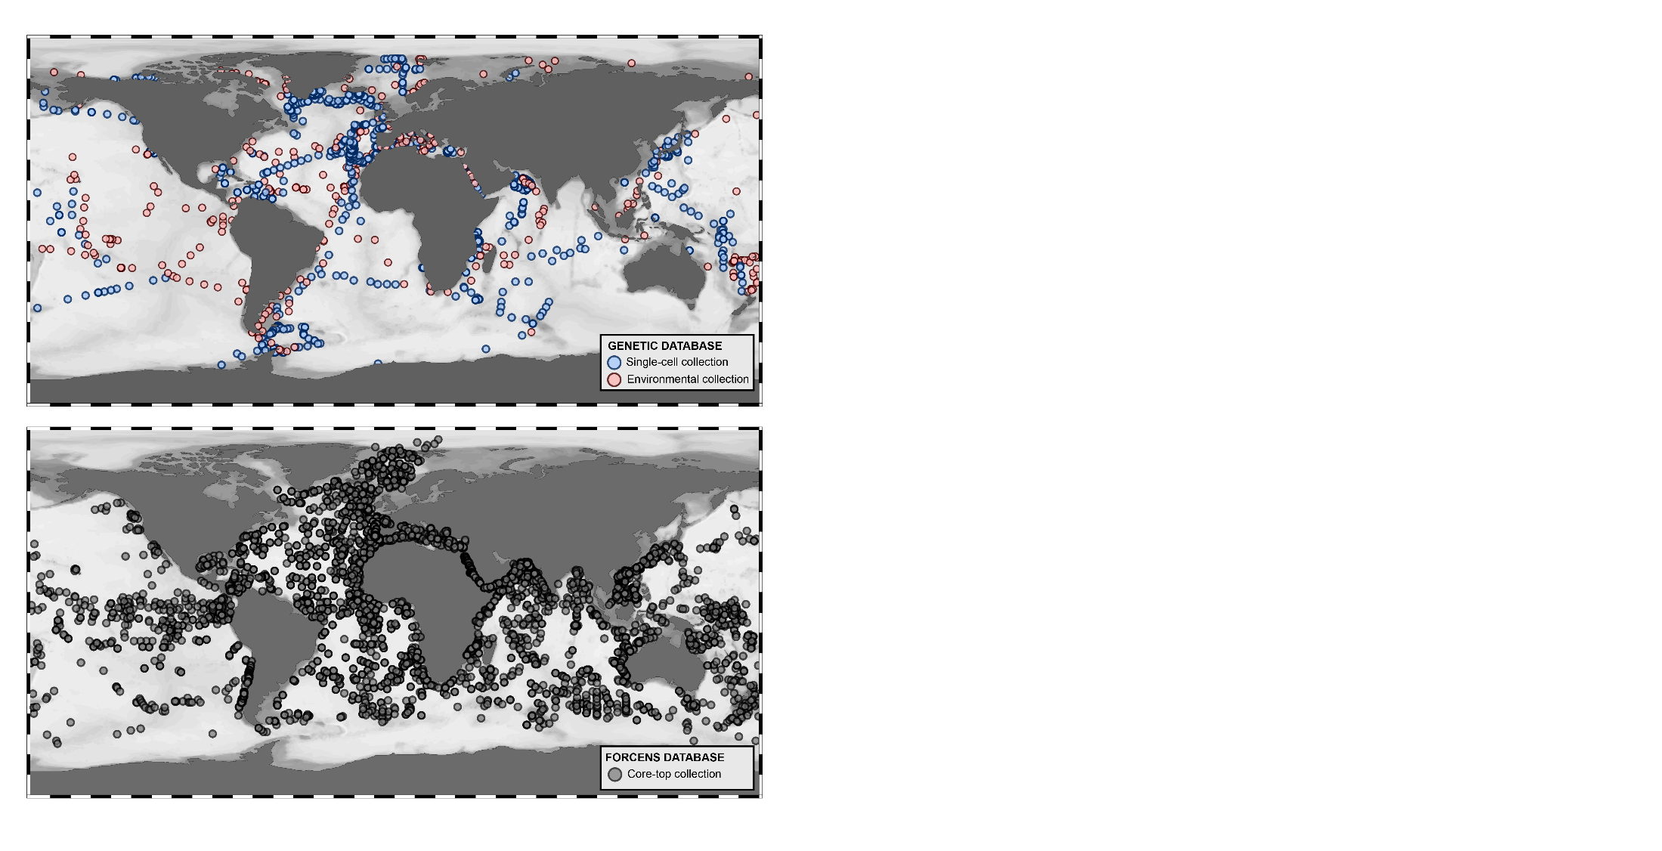
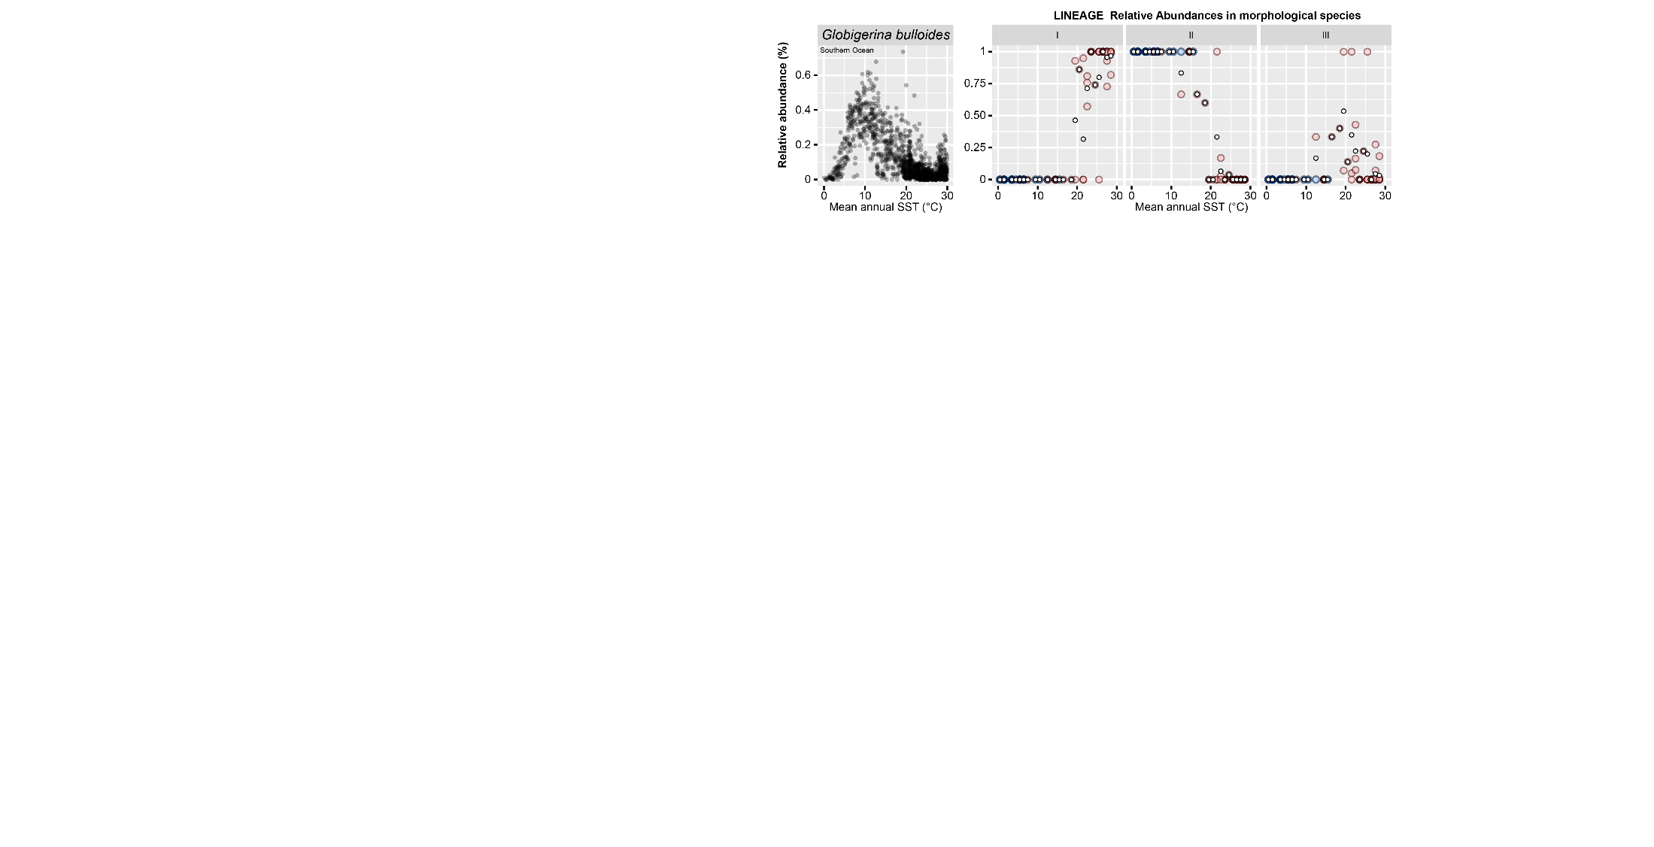
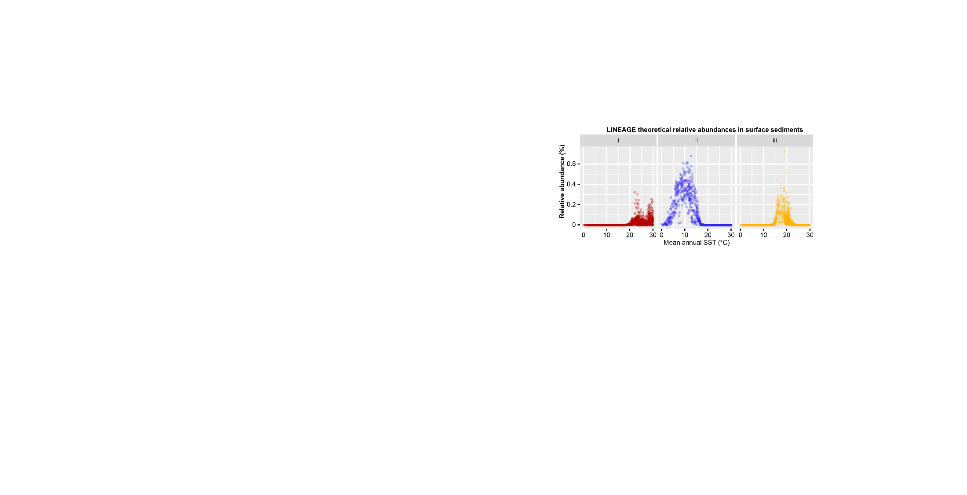
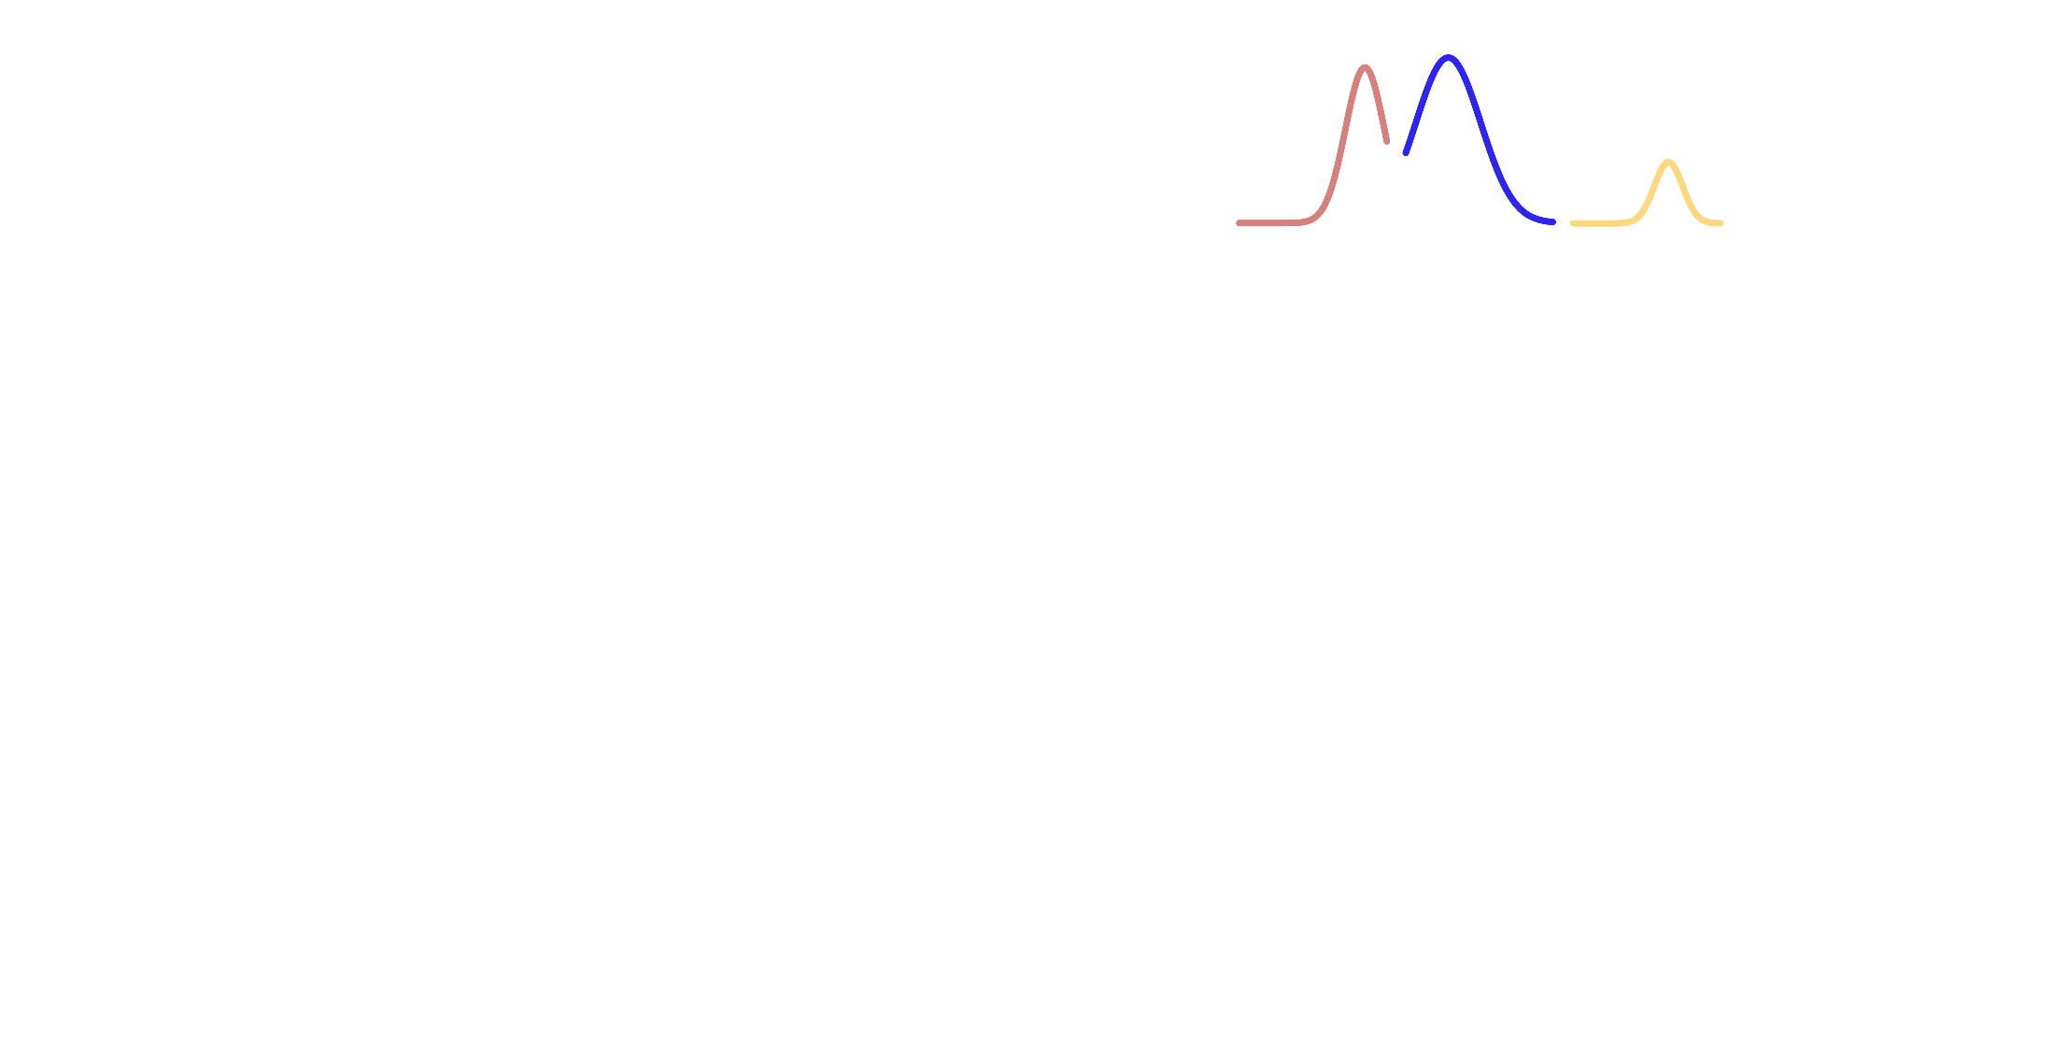
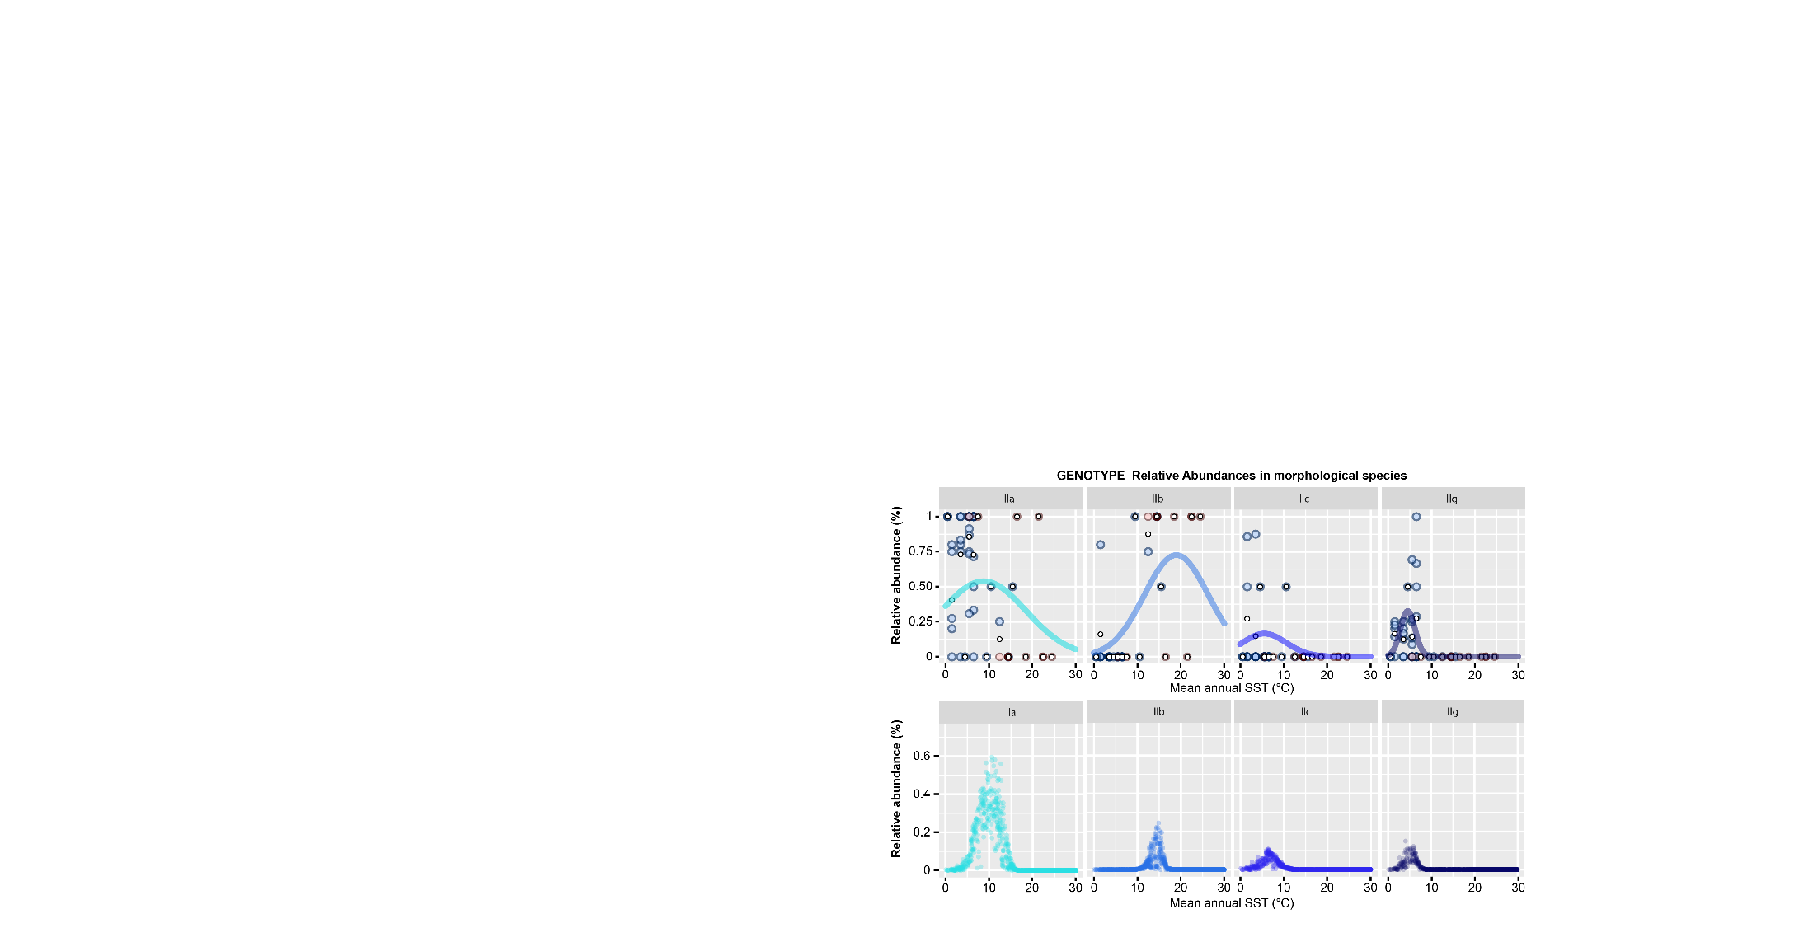

Slide 14
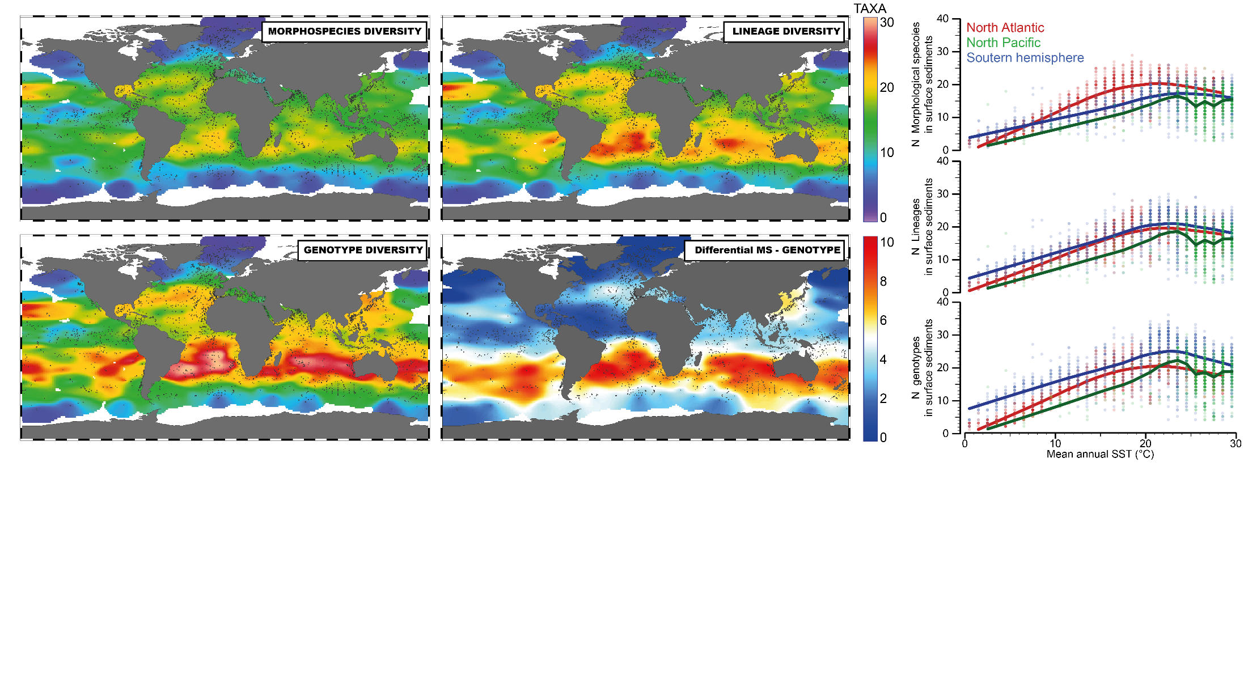
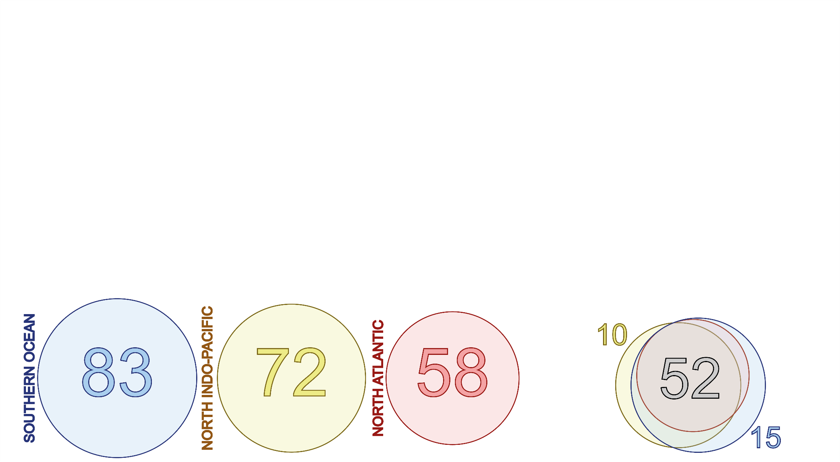

Slide 15
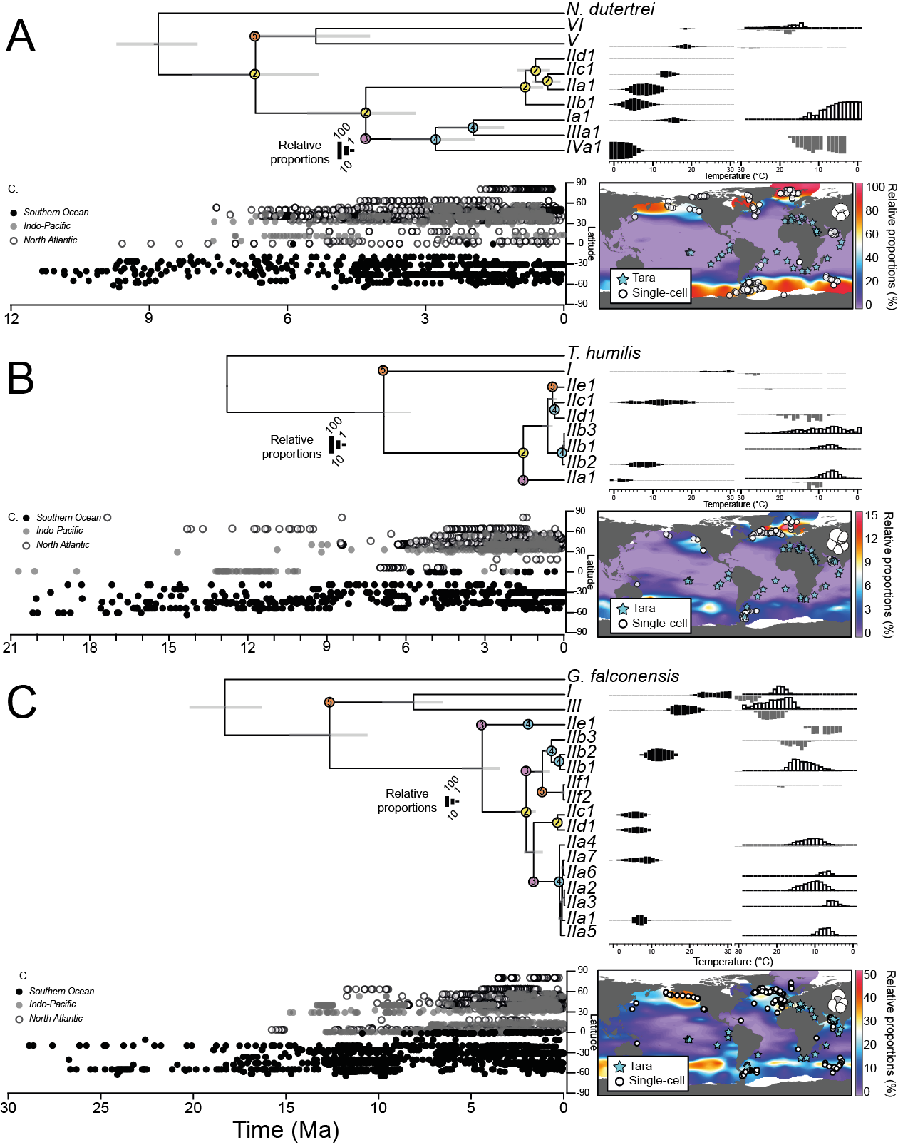
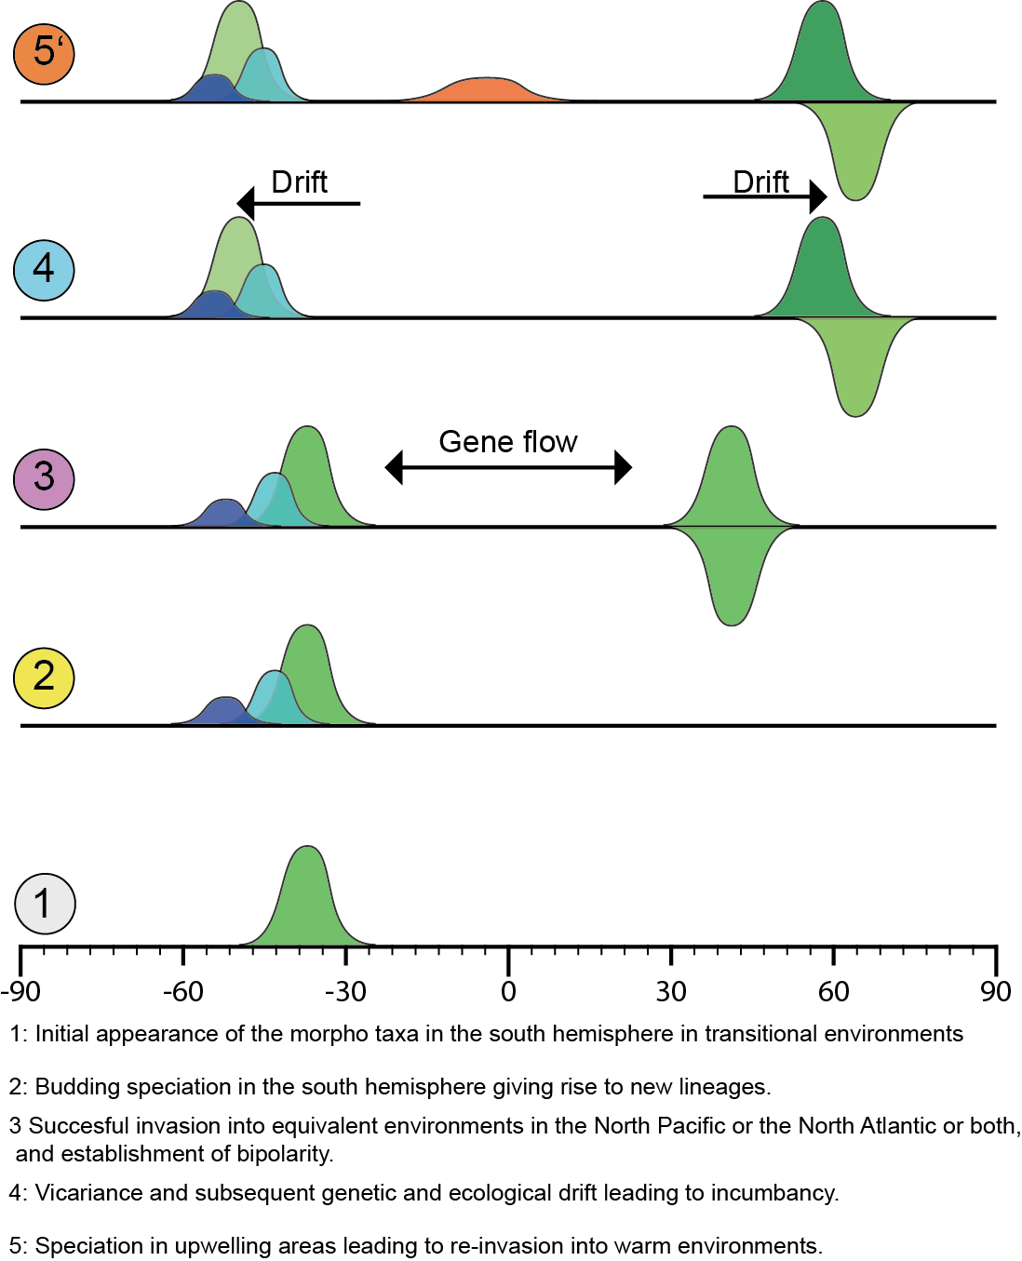

Slide 16
What is the diversity turnover of planktonic foraminifera cryptic diversity
Modeling of area of the world where diversity appear and diseapear (Source/sink)
Link to quaternary climatic dynamic.
Other?

Slide 17

Thank you for your attention - Questions ?

Slide 18
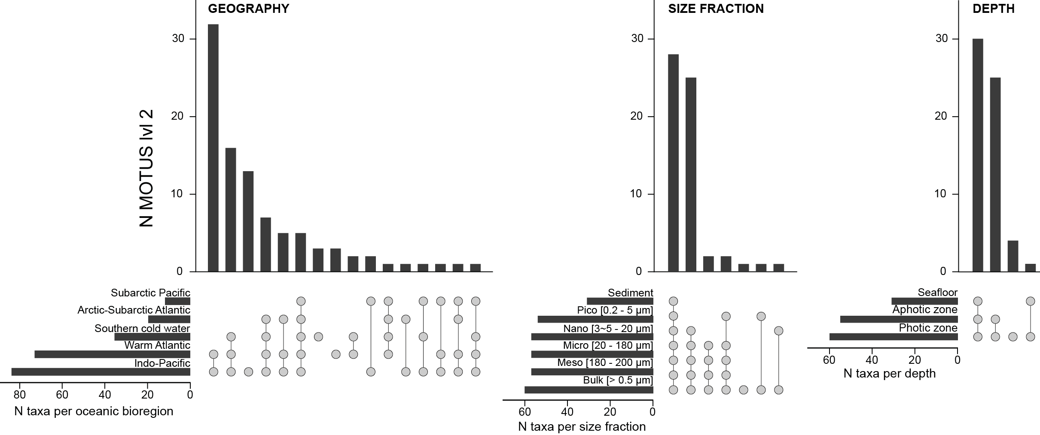
Fragmentation of diversity

Slide 19
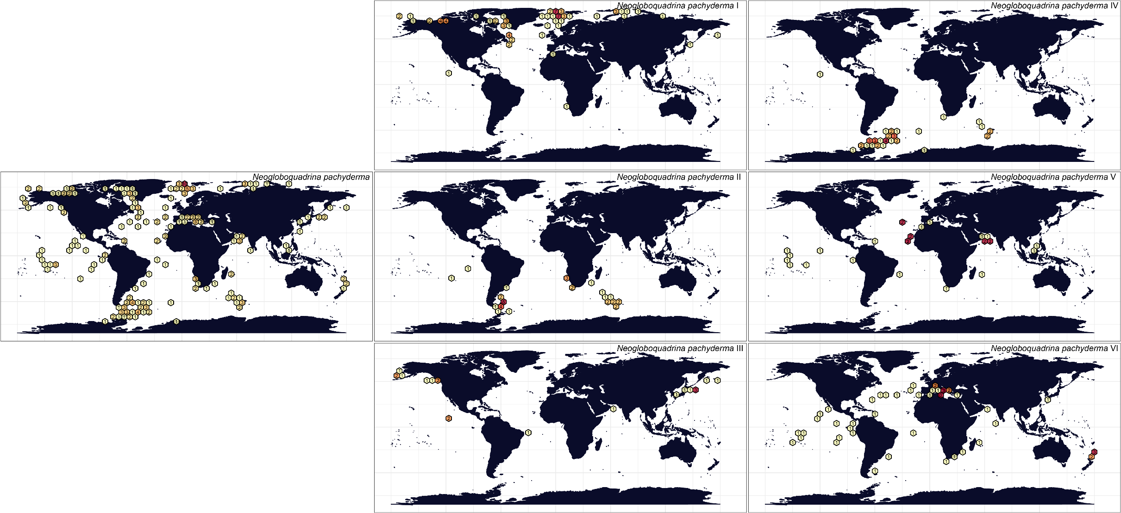
Biogeographic patterns – „Cold“ water morphospecies
Isolated
Isolated
Global
Isolated
Global-IT
Isolated
Global-IT

Slide 20
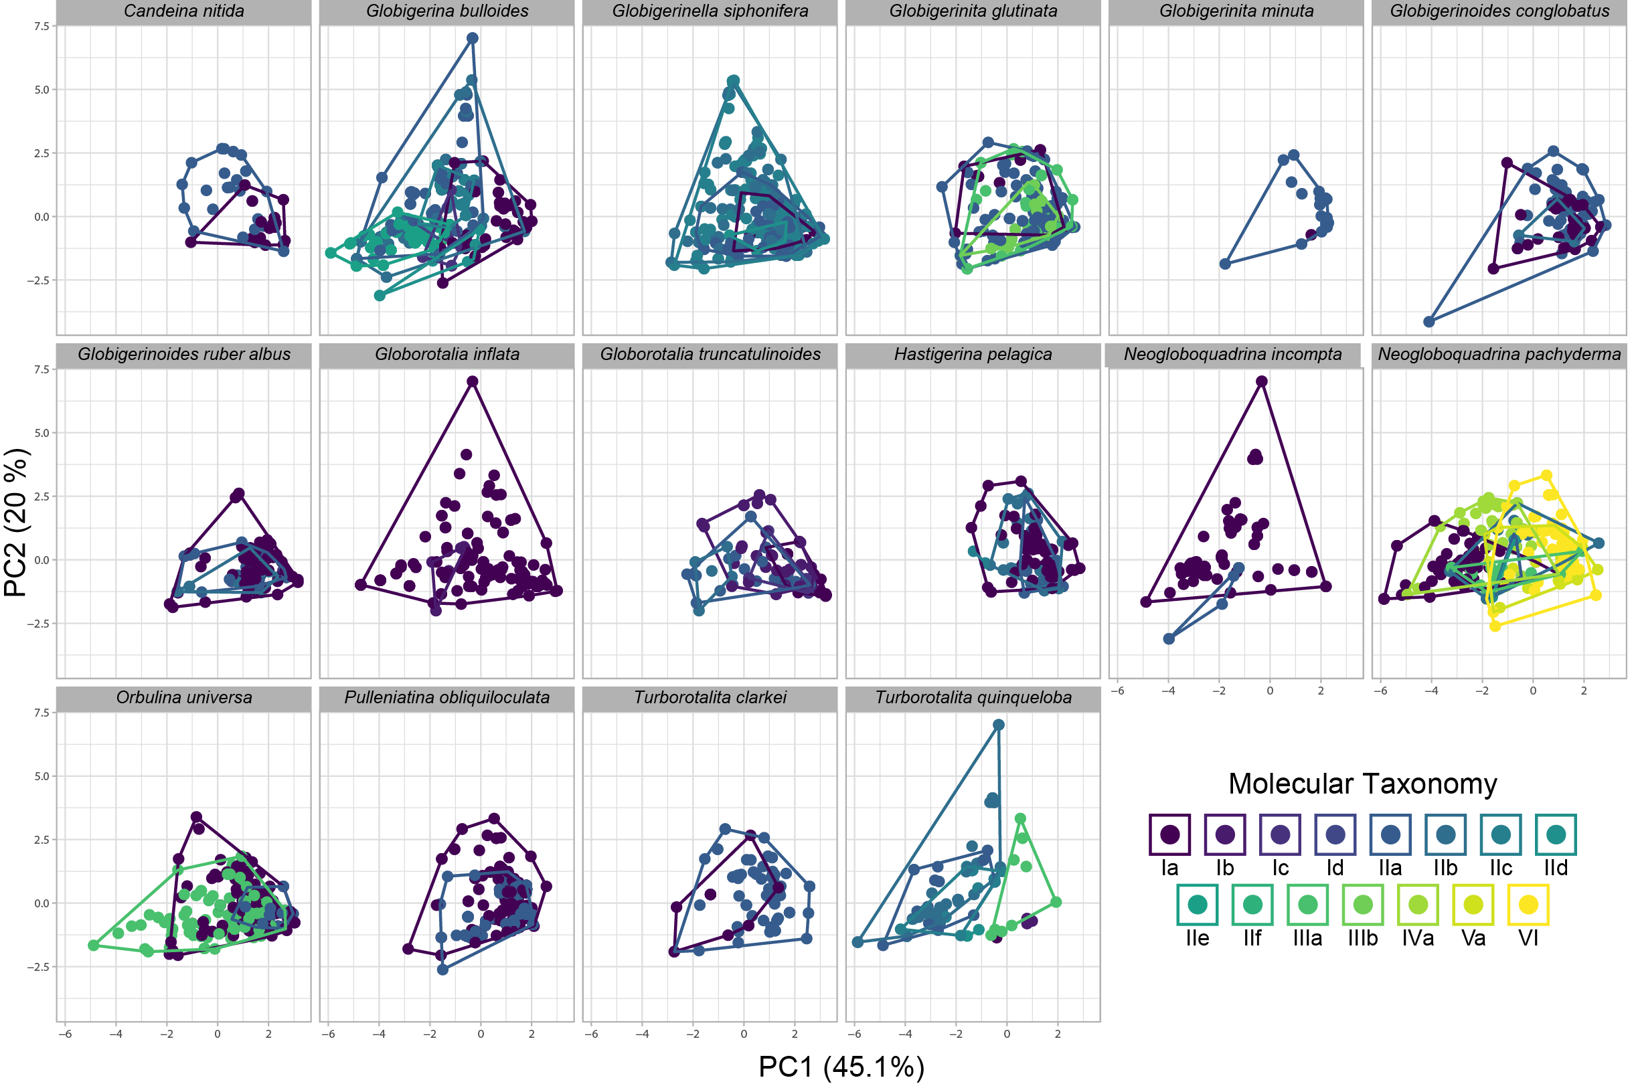

Slide 21
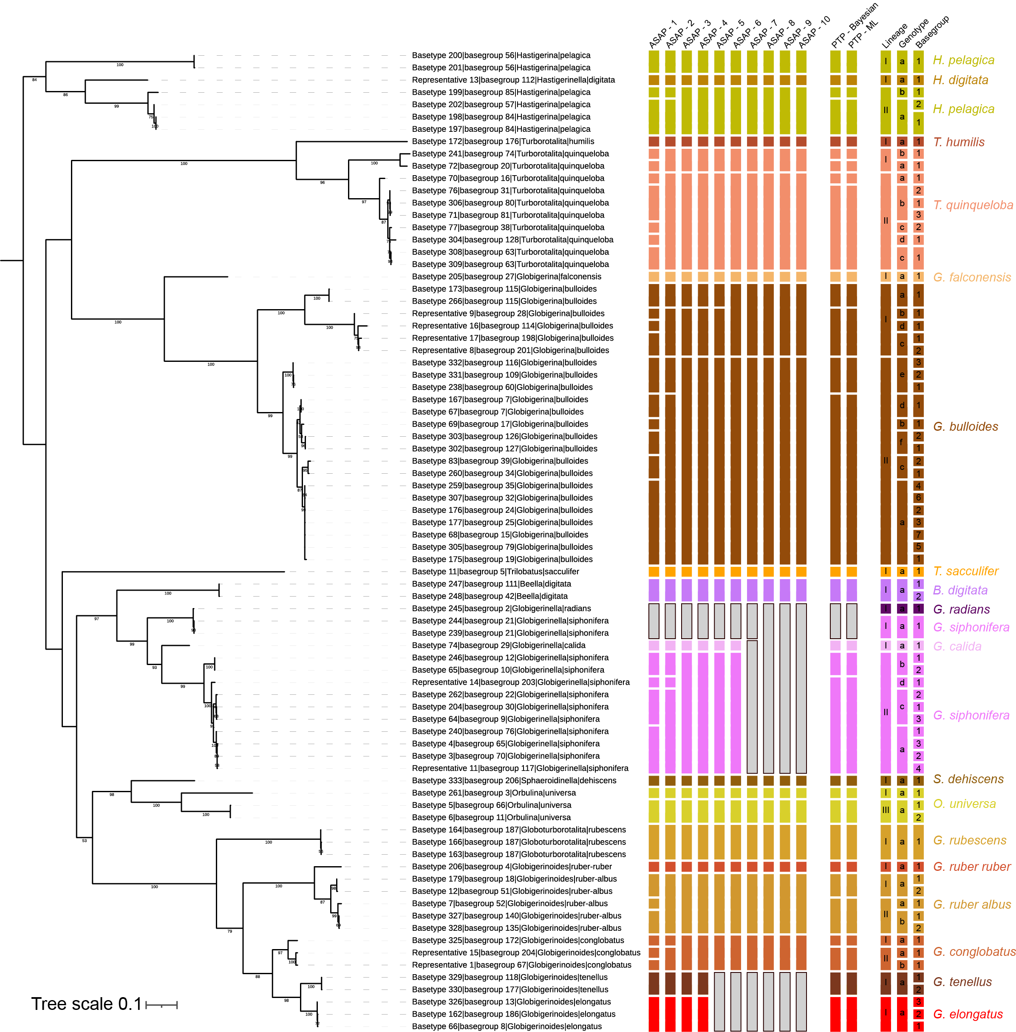
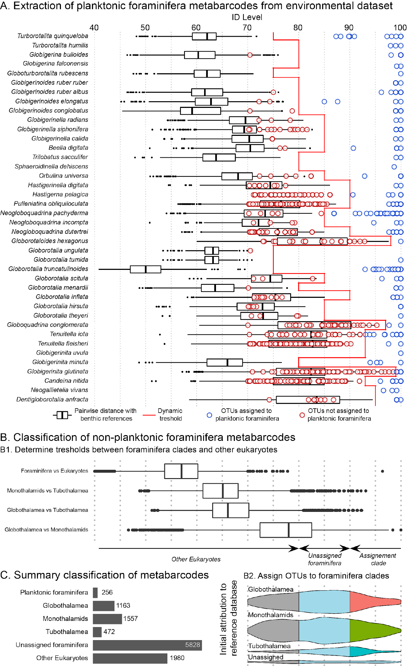

Slide 22
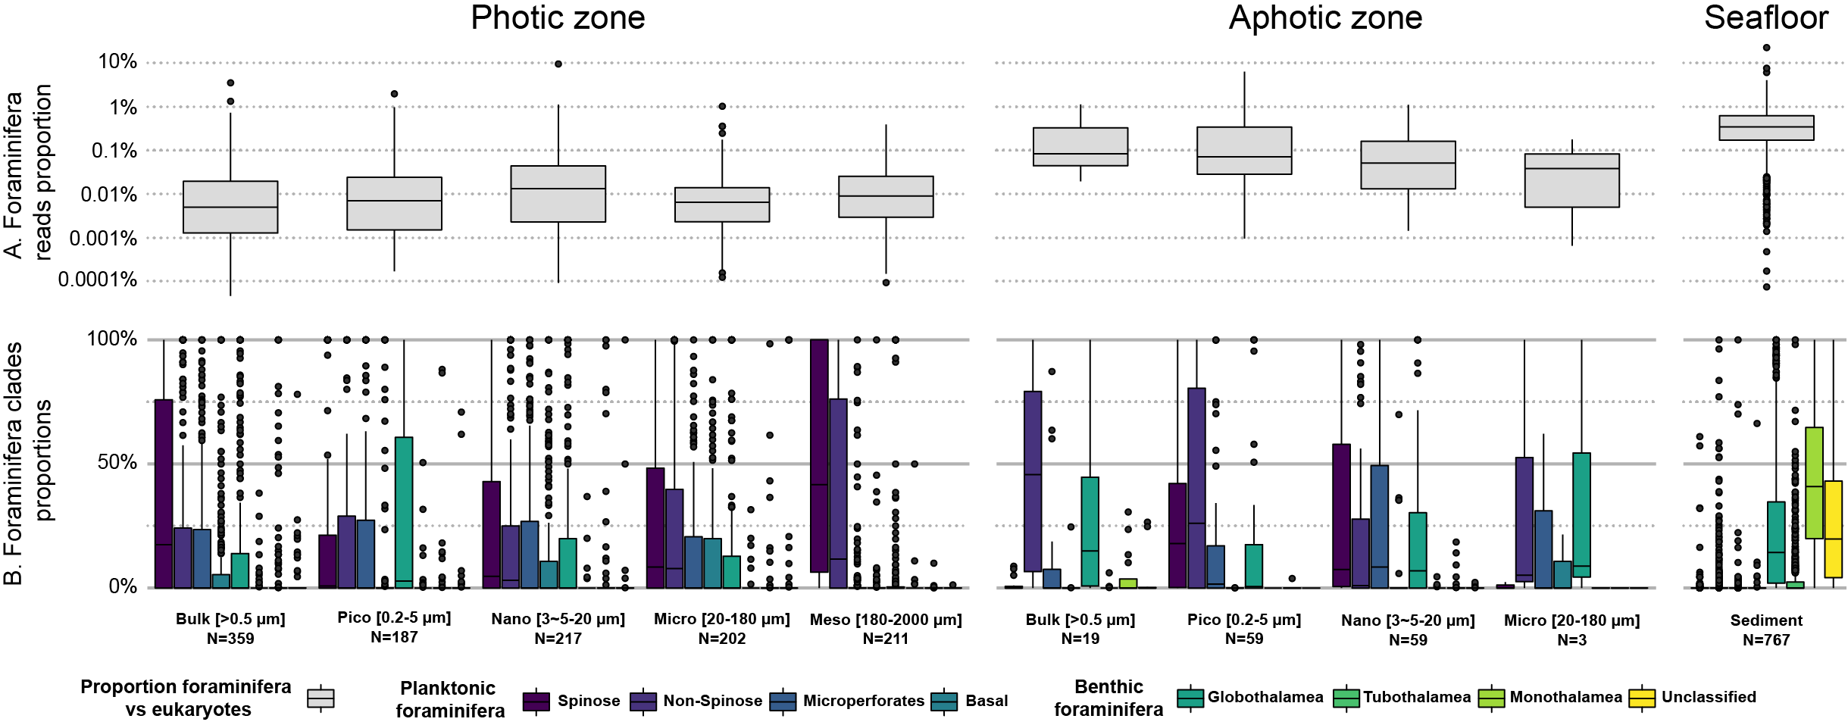
Occurence of foraminifera clades in the World Ocean
Metabarcoding dataset (V9 -Eukaryots)
Foraminifera fraction
250,000 Amplicon Sequence Variants (ASVs)
8,676 ASVs – Only 256 planktonic
Plank.
Bent.
Plank.
Bent.
Plank.
Bent.
Plank.
Bent.
Plank.
Bent.
Plank.
Bent.
Plank.
Bent.
Plank.
Bent.
Plank.
Bent.
Plank.
Bent.

Slide 23
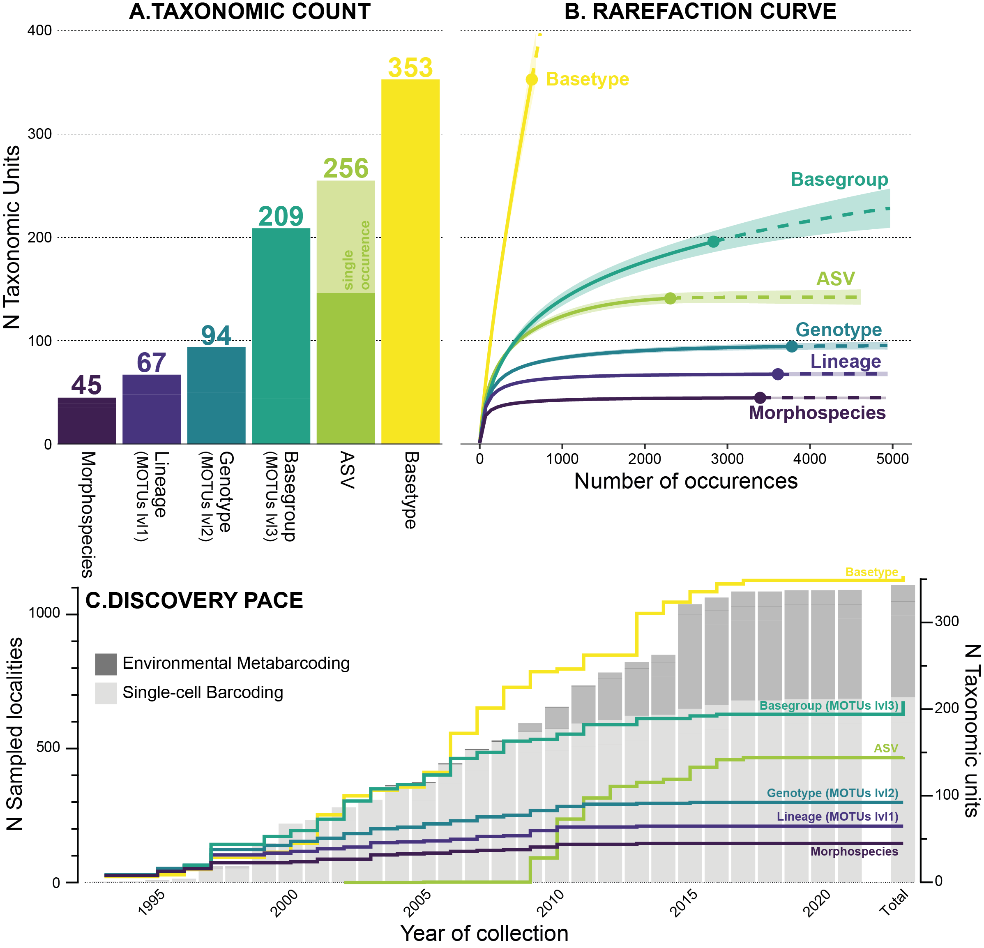
Global diversity of planktonic foraminifera

Slide 24
Global diversity of planktonic foraminifera

Slide 25
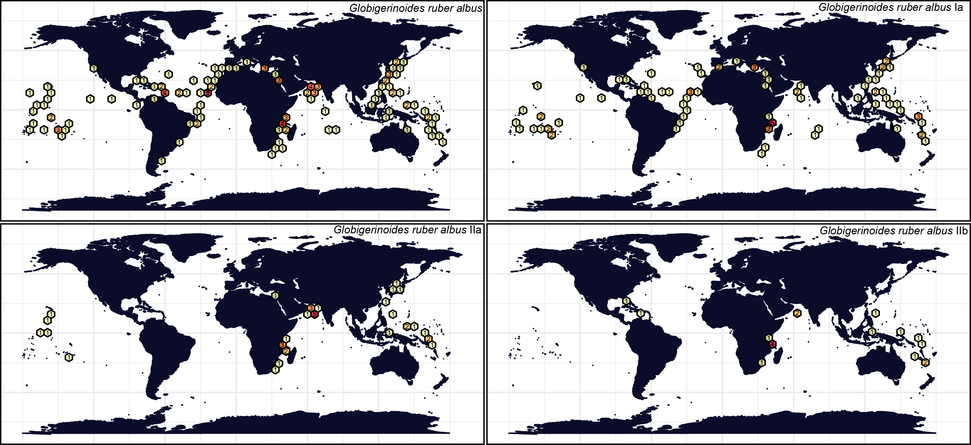
Biogeographic patterns – Warm water morphospecies
Global-IT
Global-IT
Indo-Pacific-IT
Global-IT

Slide 26
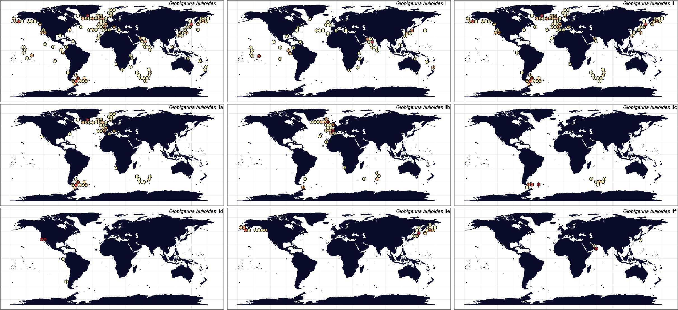
Biogeographic patterns – „Cold“ water morphospecies
Global
Global-IT
Bipolar
Bipolar
Bipolar
Isolated
Isolated
Isolated
Isolated

